Slide 1
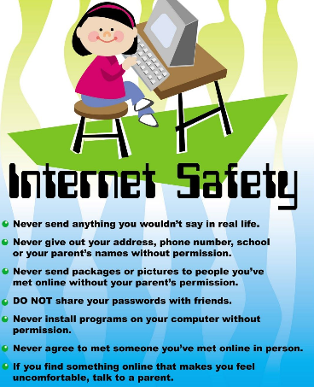
Tuesday 9th February 2021 Safer Internet Day

