Slide 1




Morning Dash - Francais

Slide 2
Relie l’anglais et le français (Match the French and the English greetings).
Bonjour Good evening
Salut Hello
Bonsoir Good night
Bonne nuit Hi

Slide 3
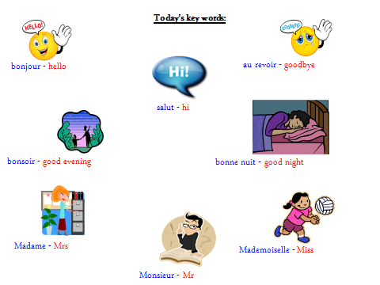
Draw a speech bubble to show you saying HELLO, HI, GOODNIGHT or GOODBYE to a friend in French.

Slide 4
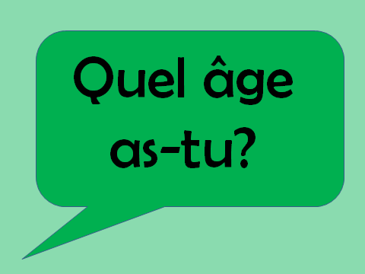
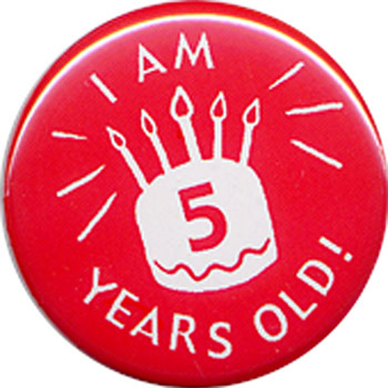
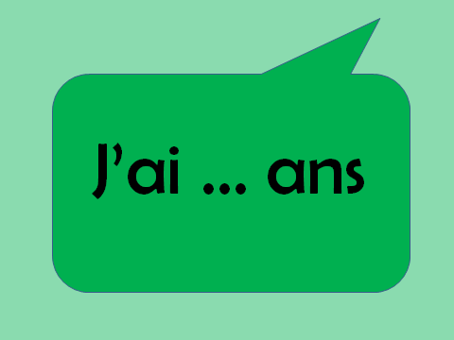
How old are you?

Slide 5
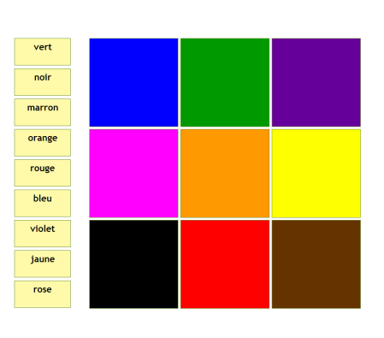
Match the word to the colour

Slide 6
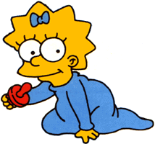
Who says what?
Salut Au revoir Bonne nuit
À bientôt Bonsoir Bonjour

Slide 7
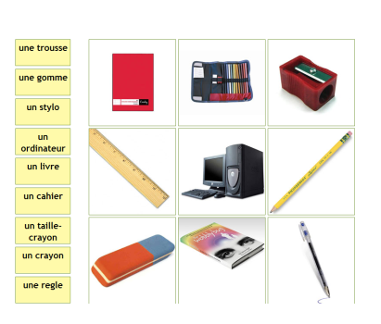
Match each word to an object found in the classroom

Slide 8
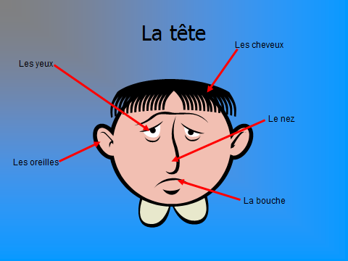
Draw your own face and label it.

Slide 9
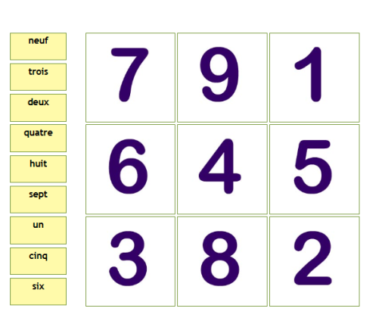
Match the numbers and words

Slide 10
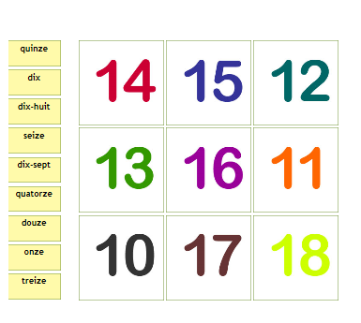
Match the words and numbers

Slide 11
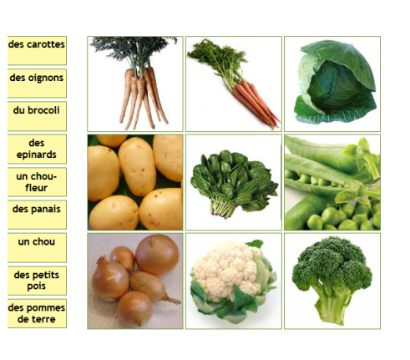
Match each word to the correct vegetable

Slide 12
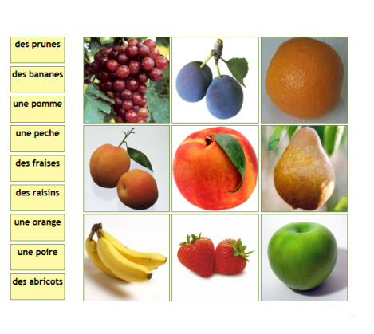
Can you match the fruit names with their pictures?

Slide 13
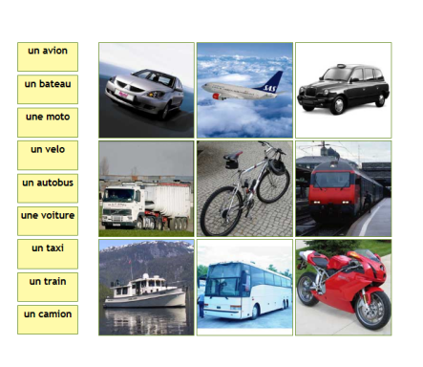
Can you match these modes of transport?

Slide 14
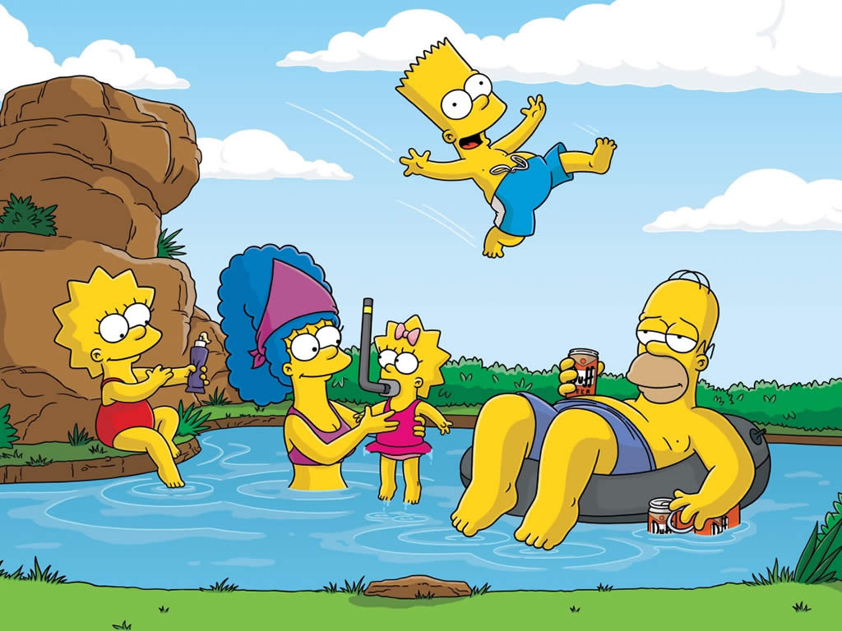
Bart est le frere. Lisa est… Marg est… Homer est…
Le frère
La mere
La sœur
Le bébé
Le père

Slide 15
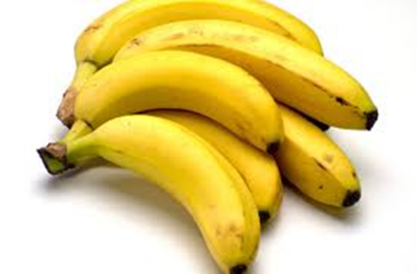
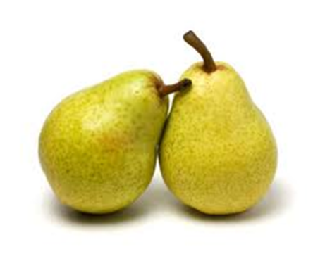
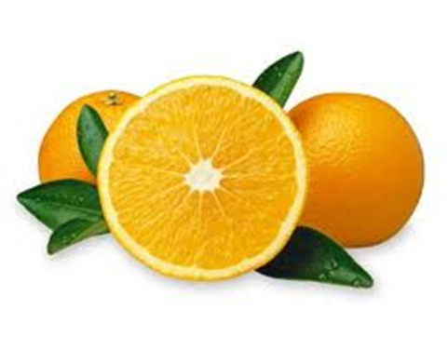
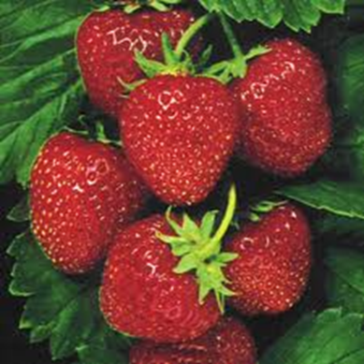
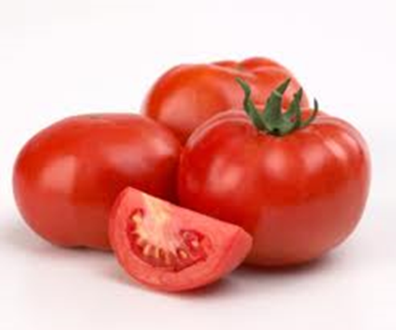
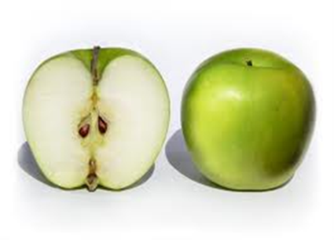
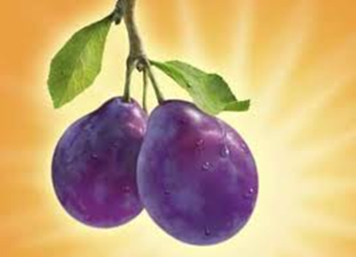
Activity
Draw and label a fruit bowl with the French fruits.
Les Oranges Les Bananes Les Poires
Les Tomates Les Prunes Les Pommes
Les Fraise

Slide 16
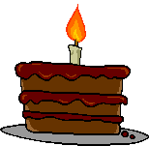
Quelle est la date de ton anniversaire?
Mon anniversaire, c’est le 30 janvier
http://www.uptoten.com/home.phtml?PageID=349&c=1&m=7alpha@cranbornemid.dorset.sch.uk

Slide 17
Tu as une soeur?
Do you have a sister? Write the answer in French and draw a picture.
Oui, j'ai une soeur.
Non, je n'ai pas de soeur.

Slide 18
Tu as un frère?
Do you have a brother? Write the answer in French and draw a picture.
Oui, j'ai un frère.
Non, je n'ai pas de frère.

Slide 19
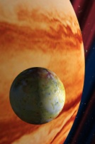
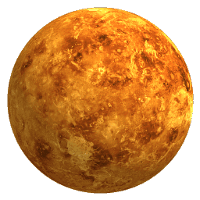
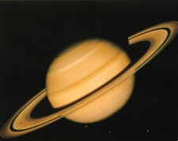
Lundi
Mardi
Mercredi
Jeudi
Vendredi
Samedi
Dimanche
What day is it today?
What day was it yesterday?
What day will it be tomorrow?
What is your favourite day?

Slide 20
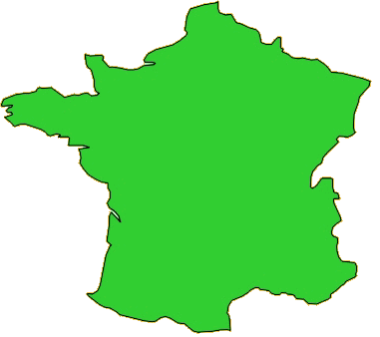
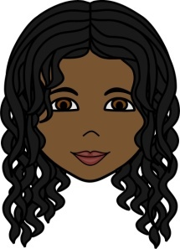


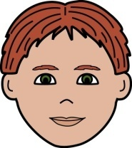

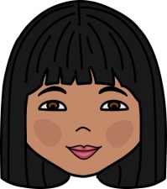
Où habites-tu?
Nom: ...................................
J’habite à Caen.
Caen
Paris
Angers
Chamonix
Bordeaux
Sarlat

Slide 21

Ça va?
(How are you?)
Ça va très bien, merci.
Ça va, merci.
Comme ci, comme ça.
Ça va mal.
How are you today?
Draw the face that shows how you feel and write the phrase that goes with it.

Slide 22
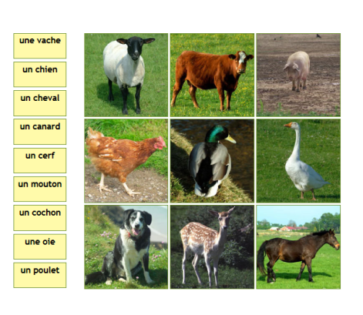
Match each animal to its name in French

Slide 23
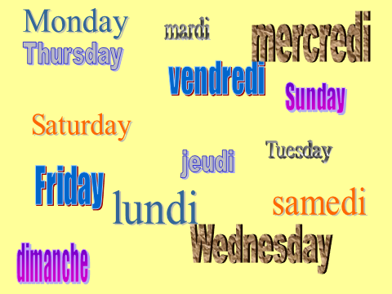
Can you match the French and English days of the week?

